Slide 1

Earth’s Features
Experience 3
Models and Maps
https://sites.google.com/wflboces.org/boces4science/home
Grade 2

Slide 2
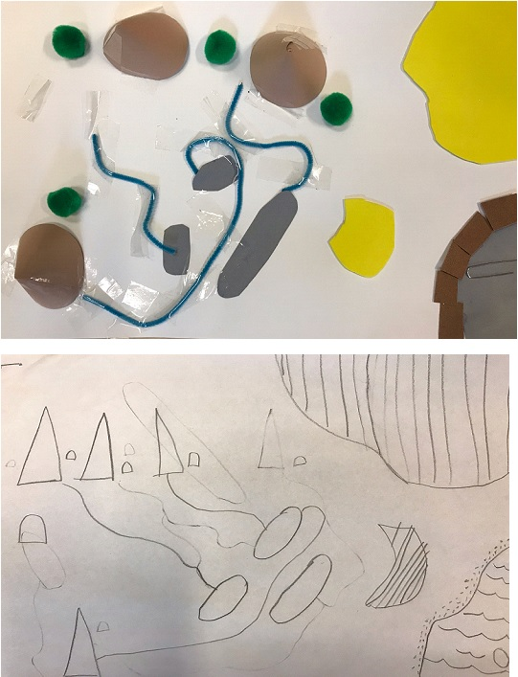
Models of landforms and water sources
Modeling in science, for example a diagram, flowchart, diorama, etc., helps students display what they are thinking. This allows us to determine if more clarification of a topic is needed or if additional information can be added to their knowledge-base.
Students have learned about some landforms and water sources, including if the water is solid or liquid.
First students should think about drawing a map that includes at least 2 land and 2 water sources.
Next students should use their map to create a model. The model can be the map but can they come up with something different. For example using flour dough (recipe on the next slide), crumpled colored paper, even going outside and using dirt, sand, or mud!

Slide 3
Salt/Flour Dough
(https://www.allrecipes.com/recipe/240641/salt-dough/print/?recipeType=Recipe&servings=4&isMetric=false)
Recipe By:IRISHEYE101
"This recipe is much like Play-Doh(R), but can be baked to a permanent finish."
Ingredients
2 cups all-purpose flour
1 cup salt
1 cup cold water
Directions
Mix flour and salt together in a bowl. Slowly mix water, a few tablespoons at a time, into flour mixture until dough is smooth and easy to handle. Knead dough for 10 minutes and let rest for 20 minutes.
Preheat oven to 250 degrees F (120 degrees C).
Form dough into desired shapes and arrange on a baking sheet.
Bake in the preheated oven until dry and hard, about 2 hours. Allow to cool completely.

Slide 4
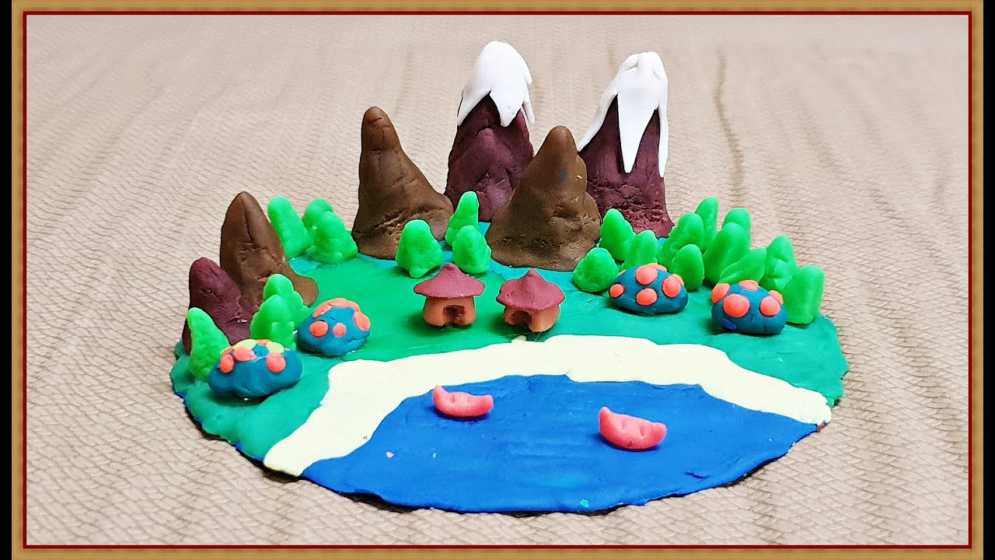
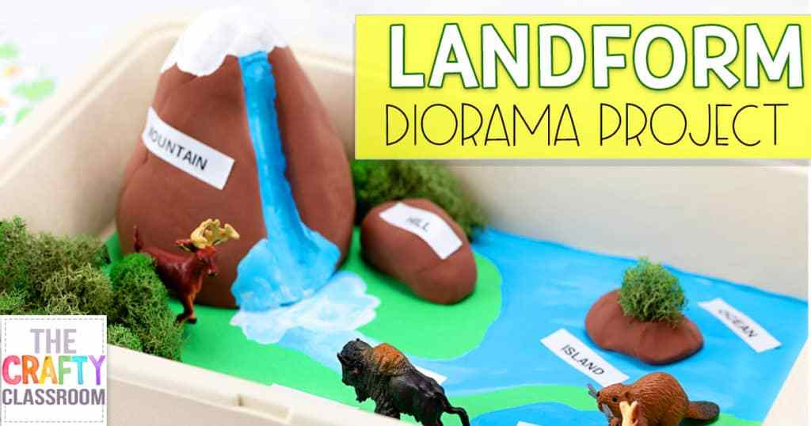
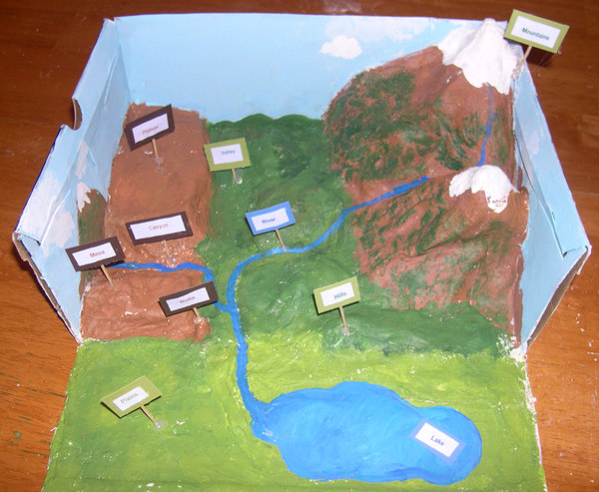
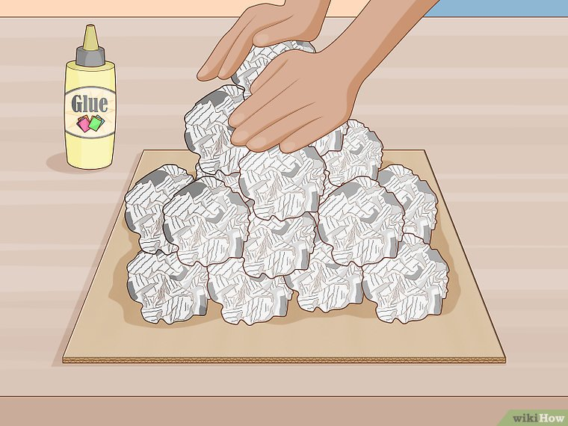
examples
https://www.youtube.com/watch?v=ArrAugBiefY
https://thecraftyclassroom.com/crafts/geology-crafts-for-kids/landform-diorama-craft/
https://cfaith979.typepad.com/charitys_crazy_beautiful_/2007/10/school-projects.html
https://www.wikihow.com/Make-a-Mountain

